Slide 1
lSTM Stock Predictor Based on Company Fundamentals
Project 2, Group 1 - Bakary Sylla, Yadisa Joiner, Marcus LeGare

Slide 2
AGENDA
Executive summary
Data Collection, Cleanup & Exploration
LSTM Model Design Methodology
Results and Analysis
Next Steps

Slide 3
Executive summary
Build a Machine Learning (ML) LSTM Recurrent Neural Network (RNN)
Model and predict the movement of Apple stock
Use:
LSTM ML techniques
Apple historical quarterly fundamental financial data features
Apple historical daily stock closing price

Slide 4
Data Collection, Cleanup & Exploration
Apple historical fundamental financial data features
Get the raw quarterly JSON data using Intrinio free trial API (https://intrinio.com/)
Raw data from 2009 to 2022, Q1, Q2, Q3, Q4 for each year included
Total of 134 features in the raw data
Store the quarterly JSON data in Pandas dataframe
Reduce the number of features to the features critical for fundamental analysis
Convert the dataframe from quarterly to daily using pandas fill forward (ffill)
Drop the NaN rows
Drop the features that have zero values

Slide 5
Data Collection, Cleanup & Exploration
Subset of available fundamental features
Quarterly operating income, Quarterly revenue, Quarterly net income
Total asset, Shareholder's equity, EPS(Basic) incl. Extraordinary items
Common Equity, Common Shares Outstanding, Dividends per share
Current assets, Current liabilities, Cash & Equivalent, Receivables
Cost of Goods Sold, Inventories, Account payable
Long term debt, Debt in current liabilities, Liabilities

Slide 6
Data Collection, Cleanup & Exploration
Apple historical stock closing price as target
Get Apple daily stock from 2008 to 2022 using yfinance API
Store the daily stock into a dataframe
Drop all the columns except stock Close and Volume
Combined fundamental features and stock data
Merge the daily fundamental features with the daily stock Close and Volume
Use the merged combined data to predict Apple daily stock closing price

Slide 7
LSTM Model design
Data preparation
Target: Daily Close price
Features: Stock volume and the important fundamental features
Split the data into training and test
Normalize the data

Slide 8
LSTM Model design
LSTM Model
Build the LSTM model
Compile the model
Fit the model
Evaluate the model on the test data
Predict the model values from test data trained using training data
Visualize the Close price predictions

Slide 9
LSTM Model design
Example LSTM Model Hyperparameters
LSTM units = neurons
input_shape = (num_timesteps, num_features)
return_sequences=True ( output the full sequence of hidden states, [h1, h2, ..., hn])
return_sequences=False (only output hn, i.e. the hidden state at the final time step.)
Dropout = reduce the overfitting of neural network
Dense units = neurons and connections used in fully connected layer
Activation = function used for the transformation of the input values of neurons
Epochs = one pass forward and backward through the neural network
Batch_size = number of samples that will be propagated through the network.

Slide 10
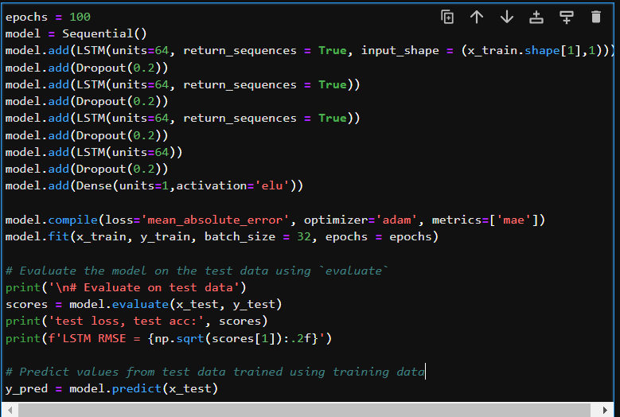
LSTM Model design
LSTM Model

Slide 11
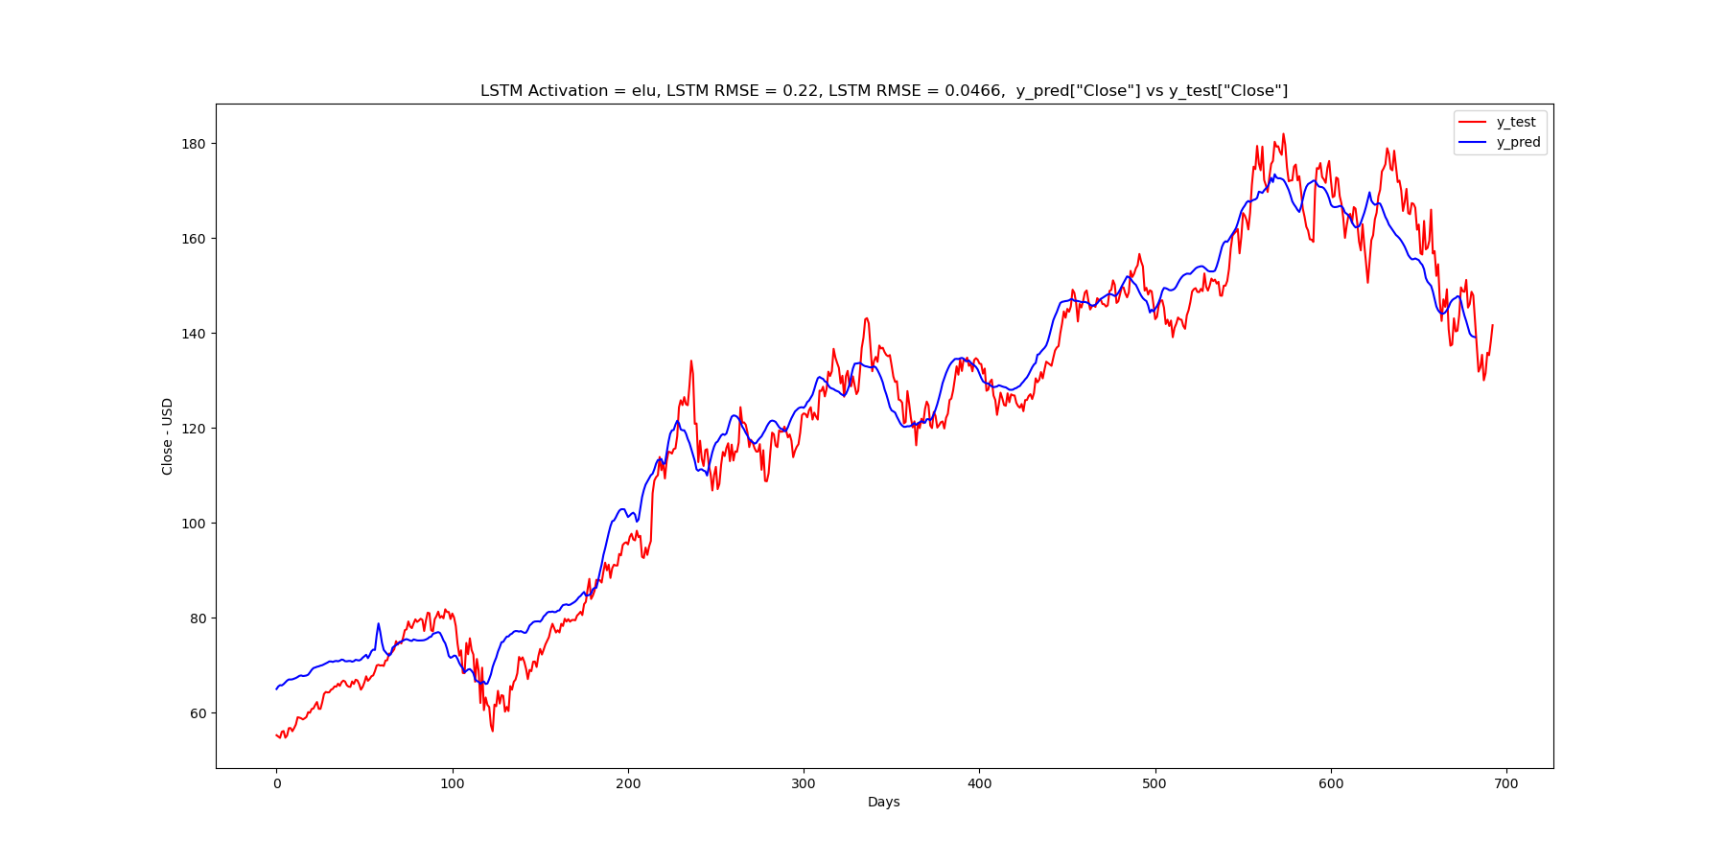
Results
LSTM Model
Activation elu, Mean Squared Error (MAE) = 0.0466, Root Mean Squared Error (RMSE) = 0.22
Apple Prediction Accuracy = ± 0.22

Slide 12
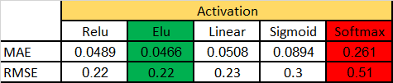
PERFORMANCE ANALYSIS
LSTM Model Accuracy for Apple Closing
Mean Squared Error (MAE)
Root Mean Squared Error (RMSE)
Best accuracy obtained with elu
Worst accuracy softmax

Slide 13
Next steps
Build LSTM Stock Forecast
Develop a Long-Short Strategy based on the prediction is greater or less than actual value
Build an FPGA Hardware Accelerator for running ML inferences.
Use specialized hardware to boost the speed and performance at which data is processed

